Slide 1
Spring and JAXB Integration (Marshalling Java Object into XML)
Add unmarshell
JAXB is an acronym for Java Architecture for XML Binding. It allows java developers to map Java class to XML representation. JAXB can be used to marshal java objects into XML and vice-versa.
It is an OXM (Object XML Mapping) or O/M framework provided by Sun
XML Marshalling – Convert Object to XML.
XML UnMarshalling – Convert XML to Object.

Slide 2
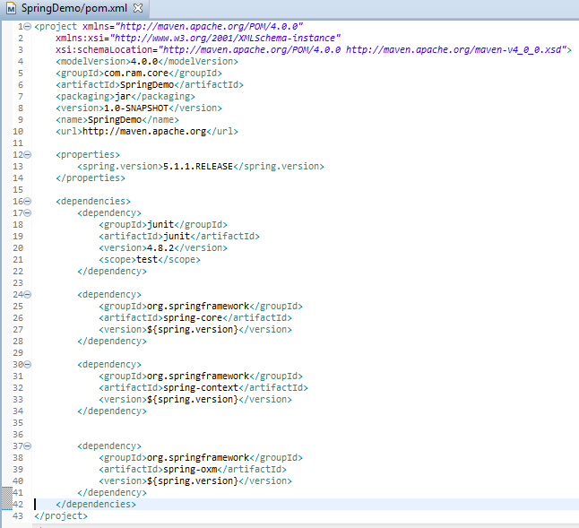
Spring and JAXB Integration (Marshalling Java Object into XML)

Slide 3
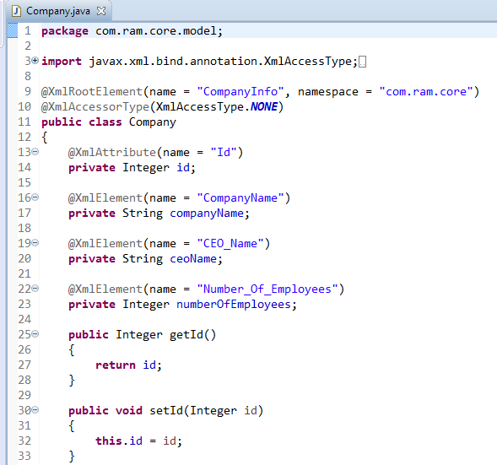

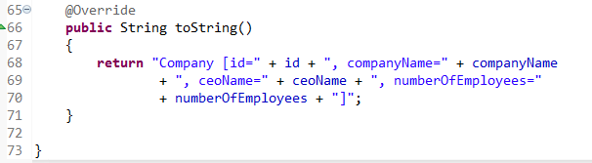
Spring and JAXB Integration (Marshalling Java Object into XML)
For XML and Java object mapping, java provides different annotations like @XmlRootElement, @XmlAccessorType, @XmlAttribute and @XmlElement.
To get java properties as XML attribute, use @XmlAttribute and for XML sub tag we need to use @XmlElement annotation on properties.
….
….

Slide 4
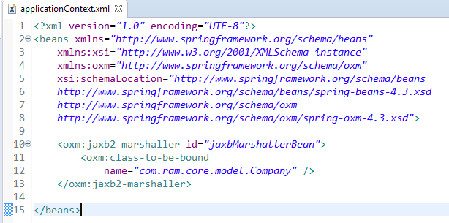
Spring and JAXB Integration (Marshalling Java Object into XML)
It defines a bean jaxbMarshallerBean where Company class is bound with the OXM framework.

Slide 5
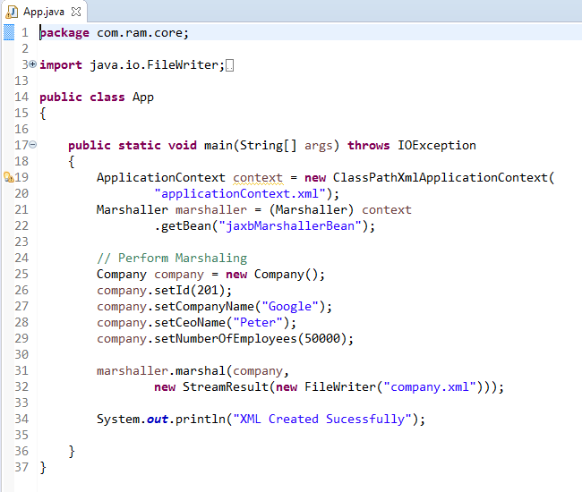
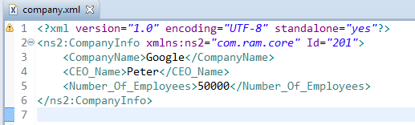

Spring and JAXB Integration (Marshalling Java Object into XML)
“company.xml” is generated in your project root folder

